Slide 1
SoC Estimation
Peerapol Yuvapoositanon

Slide 2
State of Charge (SoC) Estimation Methods: Overview and Comparison
In battery management systems (BMS), State of Charge (SoC) is like a fuel gauge for batteries — it tells how much usable energy remains. However, you can't measure SoC directly, like you can measure voltage or current. Instead, we estimate it.
There are five major classes of SoC estimation methods:

Slide 3
1. Why Estimate SoC?
The State of Charge (SoC) is a critical parameter in battery management systems (BMS). It represents the remaining charge in the battery as a percentage of its total capacity. Accurate SoC estimation is essential for:
Ensuring safe and efficient operation of the battery.
Preventing overcharging or deep discharging, which can damage the battery.
Providing users with accurate information about battery life.
However, directly measuring SoC is not possible because it is an internal state of the battery. Instead, SoC must be estimated using indirect measurements like:
Current : Used for Coulomb counting.
Voltage : Related to the Open-Circuit Voltage (OCV), which depends on SoC.
These measurements are often noisy and subject to inaccuracies, making robust estimation challenging.

Slide 4
Challenges in SoC Estimation
Several factors make SoC estimation difficult:
Measurement Noise :
Current sensors and voltage measurements are prone to noise and errors.
For example, voltage measurements may fluctuate due to temperature, internal resistance, or transient effects.
Model Uncertainty :
Battery models (e.g., OCV vs. SoC relationships) are approximations and may not perfectly represent real-world behavior.
Factors like aging, temperature, and hysteresis further complicate the model.
Drift in Coulomb Counting :
Coulomb counting estimates SoC by integrating current over time. However, small errors in current measurements accumulate over time, leading to drift.
Dynamic Behavior :
Batteries are dynamic systems where SoC changes continuously based on load conditions, making real-time estimation critical.

Slide 5
Category | Main Methods | Example Techniques
Direct Measurement | Voltage-based | Open Circuit Voltage (OCV)
Coulomb Counting | Current integration | Ampere-hour counting
Model-Based Estimation | Equivalent Circuit Models (ECM) | Kalman Filters (KF, EKF, UKF)
Adaptive / Observer-based | Online correction during operation | Luenberger Observer, Sliding Mode Observer
Data-Driven / AI-based | Machine Learning | Neural Networks (NN), Support Vector Machines (SVM)

Slide 6
Direct Measurement Methods
Example: Open Circuit Voltage (OCV)
Idea: SoC correlates to battery voltage when the battery is at rest (no current flowing).
Pros:
Very simple.
No complex modeling required.
Cons:
Only accurate when the battery is at rest for a long period (several hours sometimes).
Not usable during active operation (driving an EV, for example).

Slide 7







OCV Method
$$SoC_{V} =S_{0}+(S_{1}−S_{0})\frac{V−V_{0}}{V_{1}−V_{0}}$$
SoC
$$S_{1}$$
$$SoC_{V}$$
$$S_{0}$$
$$V_{0}$$
$$V$$
OCV
$$V_{1}$$

Slide 8
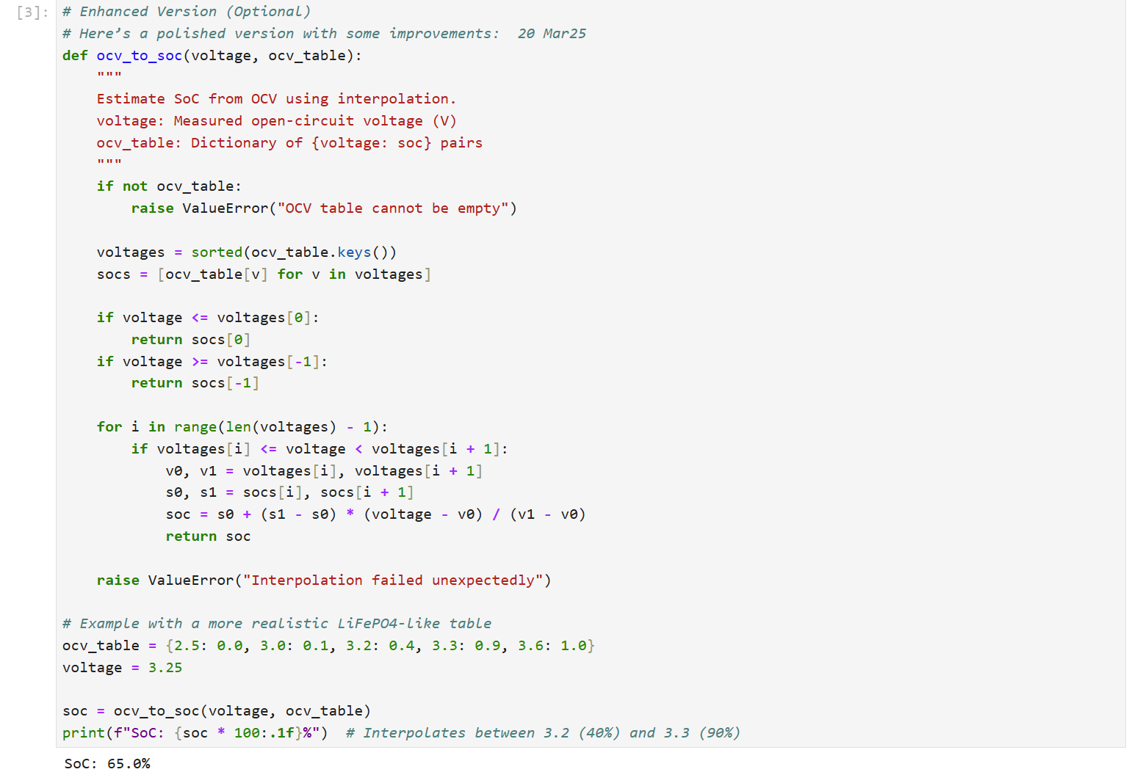

Slide 9
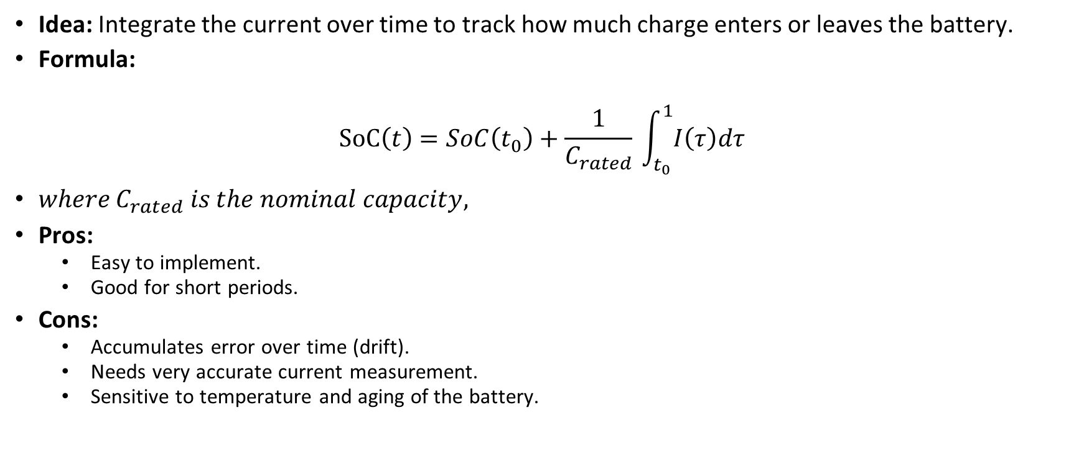
Coulomb Counting (Current Integration)
Idea: Integrate the current over time to track how much charge enters or leaves the battery.
Formula:
$$SoC\left(t\right)=SoC\left(t_{0}​\right)+\frac{1}{C_{rated}}​\int_{t_{0}}^{1}{​I\left(τ\right)dτ}$$
$where C_{rated}​ is the nominal capacity,$
Pros:
Easy to implement.
Good for short periods.
Cons:
Accumulates error over time (drift).
Needs very accurate current measurement.
Sensitive to temperature and aging of the battery.

Slide 10
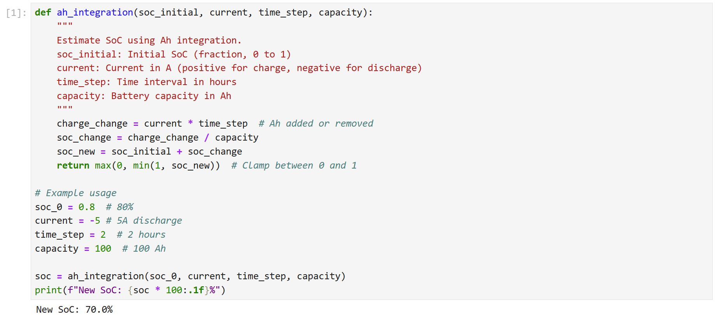
Ah Integration Method

Slide 11
Model-Based Estimation (Kalman Filters)
Idea: Model the battery using electrical equivalents (resistors, capacitors) and apply estimation techniques.
Popular Tools:
Extended Kalman Filter (EKF)
Unscented Kalman Filter (UKF)
Pros:
Good balance between accuracy and real-time performance.
Can correct for some noise and errors.
Cons:
Requires good battery models.
More complex to implement.
Computationally heavier than simple counting.

Slide 12
Why Use a Kalman Filter?
The Kalman Filter is an ideal tool for SoC estimation because it addresses the above challenges effectively:
Combines Predictions and Measurements :
The Kalman Filter uses Coulomb counting (current integration) to predict SoC and then refines the prediction using voltage measurements .
This combination reduces reliance on either method alone, improving accuracy.
Handles Noise :
The filter accounts for uncertainties in both the prediction (process noise) and measurements (measurement noise).
By weighting predictions and measurements based on their respective uncertainties, the Kalman Filter minimizes the impact of noise.

Slide 13
Recursive and Real-Time :
The Kalman Filter operates recursively, updating the SoC estimate at each time step. This makes it suitable for real-time applications like BMS.
Optimal Estimation :
Under the assumptions of linearity and Gaussian noise, the Kalman Filter provides the minimum mean square error (MMSE) estimate of the state.

Slide 14
The Extended Kalman Filter (EKF) is a powerful extension of the standard Kalman Filter that allows it to handle nonlinear systems.
In a nonlinear system, the state transition and measurement models are expressed as:

Slide 15
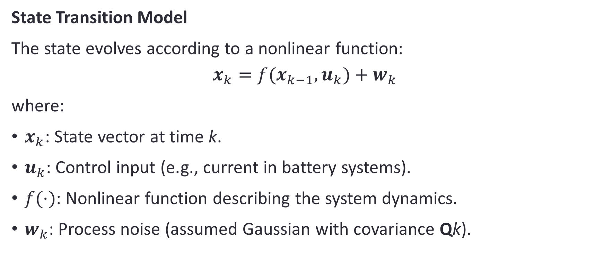
Problem Setup
State Transition Model
The state evolves according to a nonlinear function:
$$x_{k}​=f(x_{k−1}​,u_{k}​)+w_{k}​$$
where:
$x_{k}​$: State vector at time k.
$u_{k}​$: Control input (e.g., current in battery systems).
$f(⋅)$: Nonlinear function describing the system dynamics.
$w_{k}​$: Process noise (assumed Gaussian with covariance Qk​).

Slide 16
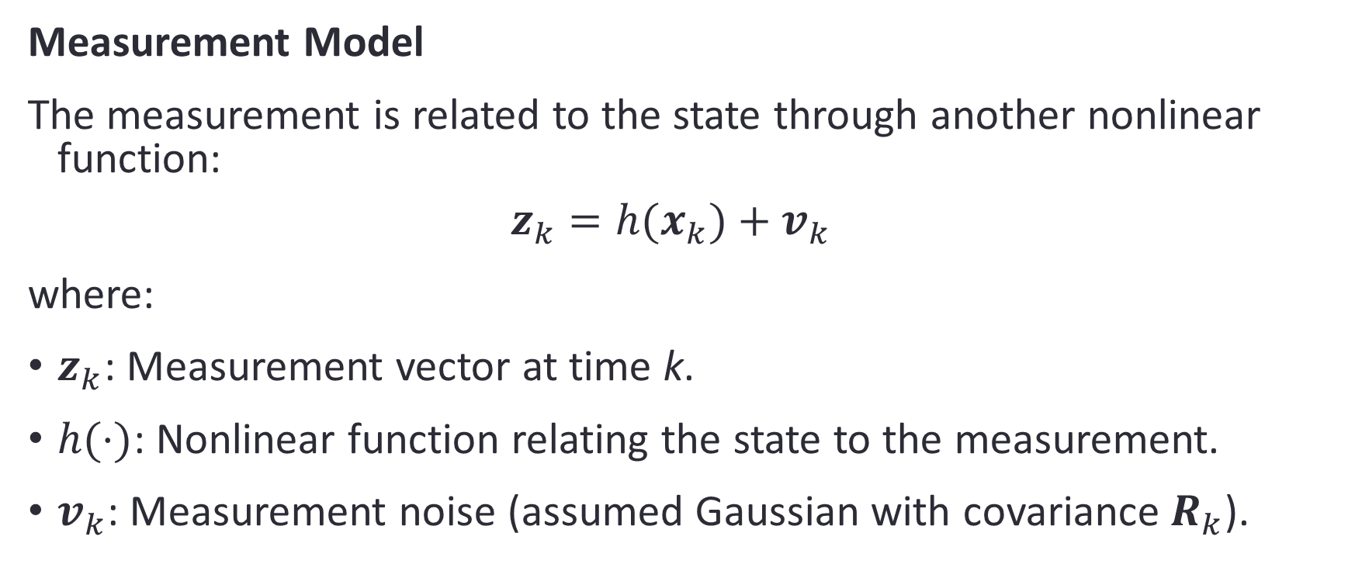
Measurement Model
The measurement is related to the state through another nonlinear function:
$$z_{k}​=h(x_{k}​)+v_{k}​$$
where:
$z_{k}$​: Measurement vector at time k.
$h(⋅)$: Nonlinear function relating the state to the measurement.
$v_{k}​$: Measurement noise (assumed Gaussian with covariance $R_{k}​$).

Slide 17
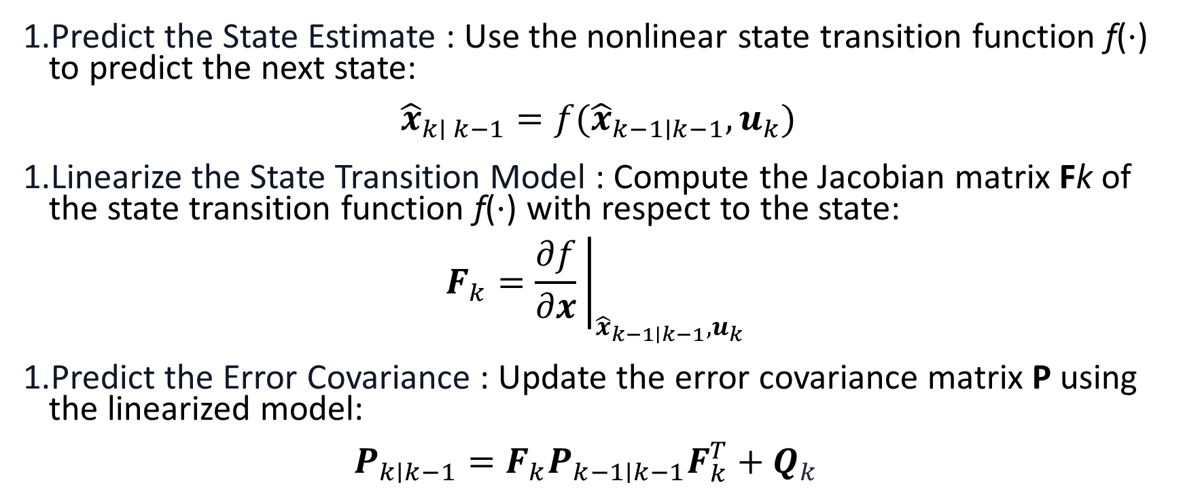
Step 1: Prediction
Predict the State Estimate : Use the nonlinear state transition function f(⋅) to predict the next state:
$${\hat{x}}_{k∣ k−1}​=f({\hat{x}}_{k−1∣k−1}​,u_{k}​)$$
Linearize the State Transition Model : Compute the Jacobian matrix Fk​ of the state transition function f(⋅) with respect to the state:
$$F_{k}​={\left.\frac{∂f}{∂x}​\right|}_{{\hat{x}}_{k−1∣k−1​},u_{k}}​​​$$
Predict the Error Covariance : Update the error covariance matrix P using the linearized model:
$$P_{k∣k−1}​=F_{k}​P_{k−1∣k−1}​F_{k}^{T}​+Q_{k}​$$

Slide 18
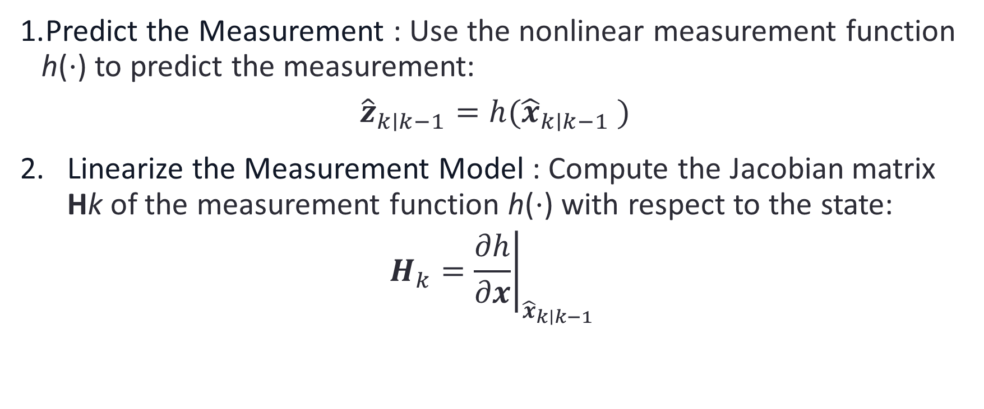
Step 2: Update
Predict the Measurement : Use the nonlinear measurement function h(⋅) to predict the measurement:
$${\hat{z}}_{k∣k−1}​=h({\hat{x}}_{k∣k−1} ​)$$
Linearize the Measurement Model : Compute the Jacobian matrix Hk​ of the measurement function h(⋅) with respect to the state:
$$H_{k}​={\left.\frac{∂h}{∂x}\right|}_{{\hat{x}}_{k∣k−1}​​}​​$$

Slide 19
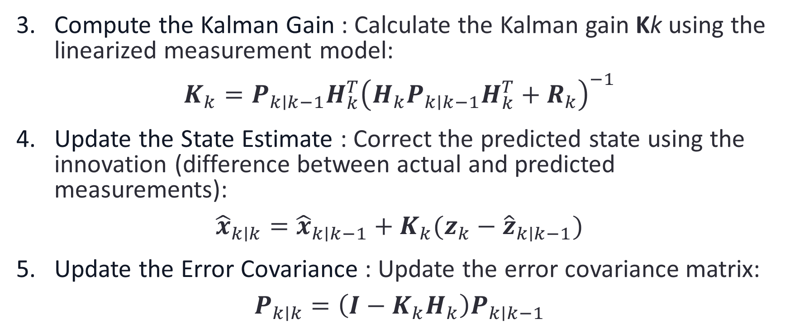
Compute the Kalman Gain : Calculate the Kalman gain Kk​ using the linearized measurement model:
$$K_{k}​=P_{k∣k−1}​H_{k}^{T}​{\left(H_{k}​P_{k∣k−1}​H_{k}^{T}​+R_{k​}\right)}^{−1}$$
Update the State Estimate : Correct the predicted state using the innovation (difference between actual and predicted measurements):
$${\hat{x}}_{k∣k}​={\hat{x}}_{k∣k−1}​+K_{k}​(z_{k}​−{\hat{z}}_{k∣k−1}​)$$
Update the Error Covariance : Update the error covariance matrix:
$$P_{k∣k}​=\left(I−K_{k}​H_{k}​\right)P_{k∣k−1}​$$

Slide 20
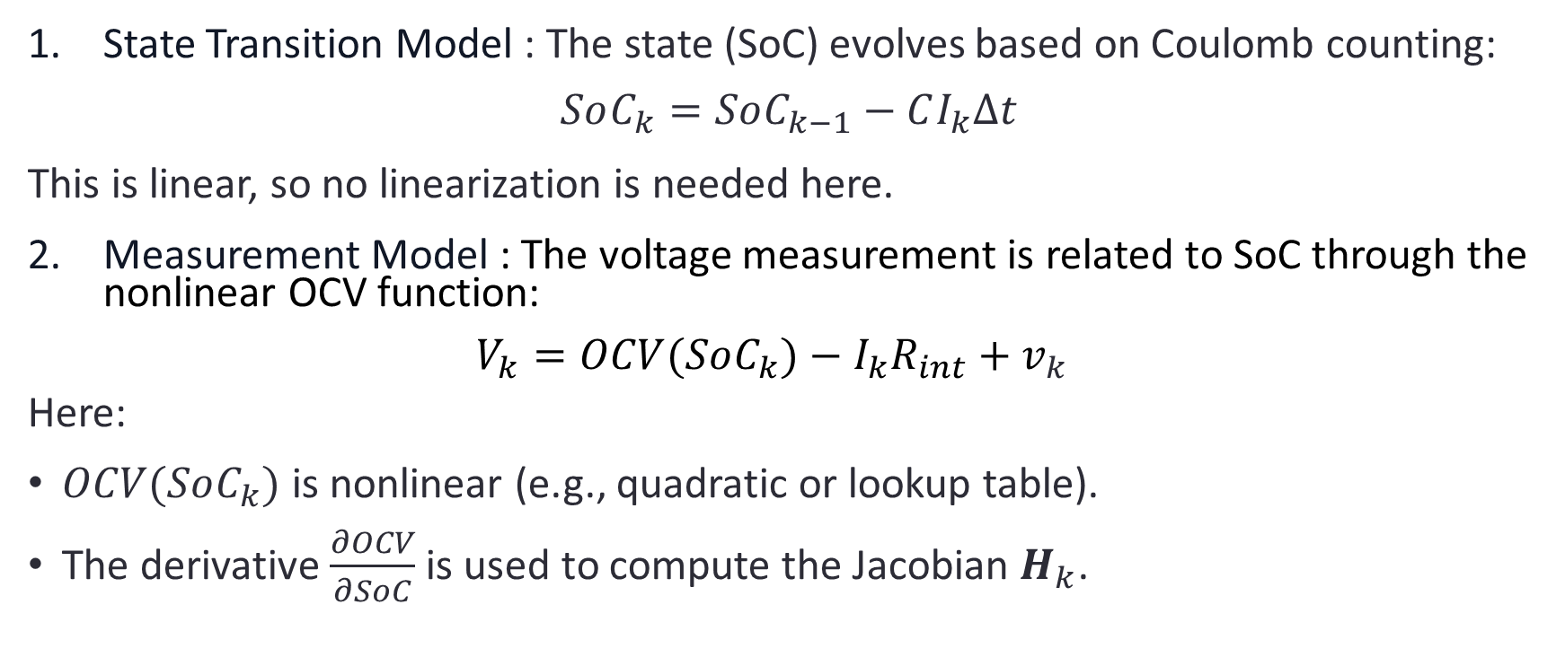
Application to Battery SoC Estimation
State Transition Model : The state (SoC) evolves based on Coulomb counting:
$$SoC_{k}​=SoC_{k−1}​−CI_{k}​Δt​$$
This is linear, so no linearization is needed here.
Measurement Model : The voltage measurement is related to SoC through the nonlinear OCV function:
$$V_{k}​=OCV(SoC_{k}​)−I_{k}​R_{int}​+v_{k}​$$
Here:
$OCV(SoC_{k}​)$is nonlinear (e.g., quadratic or lookup table).
The derivative $\frac{∂OCV}{∂SoC}$is used to compute the Jacobian $H_{k}​$.

Slide 21
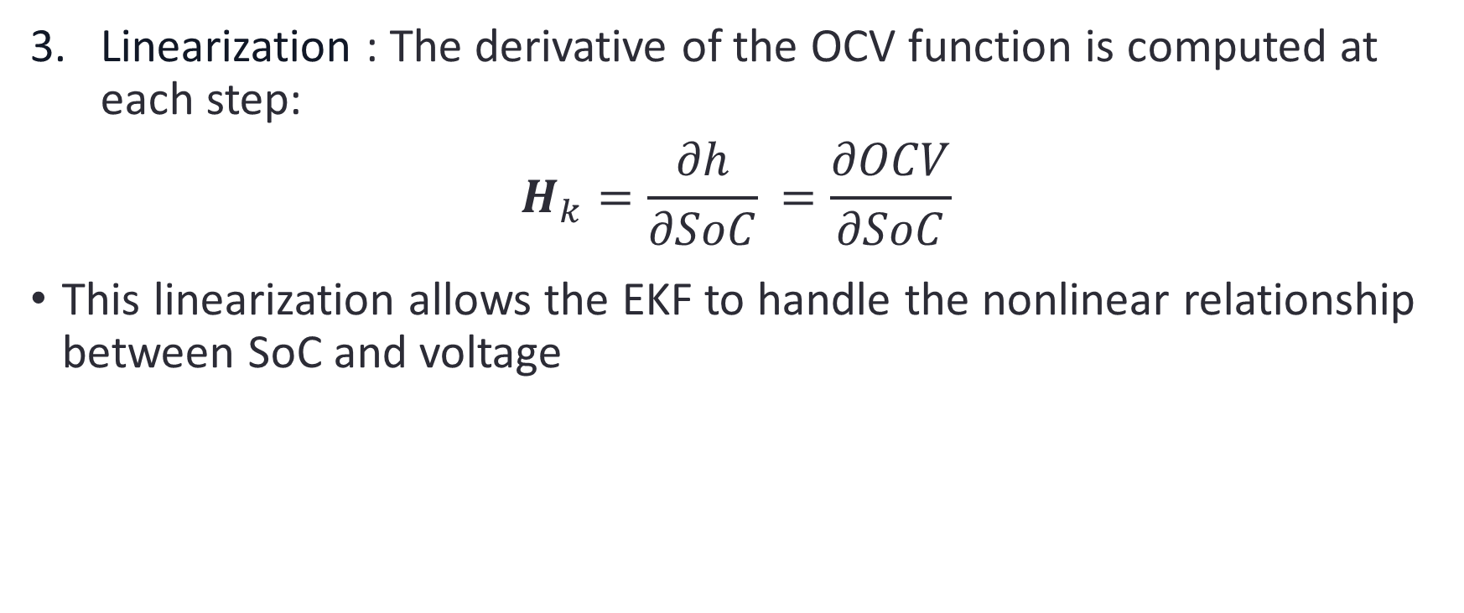
Linearization : The derivative of the OCV function is computed at each step:
$$H_{k}​=\frac{∂h}{∂SoC}​=\frac{∂OCV}{∂SoC}​$$
This linearization allows the EKF to handle the nonlinear relationship between SoC and voltage

